Slide 1
Music Recommendation with LFM-1b Dataset
Gasper Qian, Dongyang Wang, Wendan (Emily) Yan

Slide 2
Overview
Recommend artists to users
Purpose: Users can obtain music recommendations that best fit their tastes.
Models: collaborative filtering, demographic filtering, factorization machine, hybrid filtering.
Approach: 90-10 train-test split
Evaluation: precision, recall, and the F-1 score
Notes:
In this project, we design several recommendation systems
Recommend music to users based on their personal background, such as gender, age, country, similar users, etc.
Purpose: utilize the recommendation systems such that the users can obtain music recommendations that best fit their tastes.
Models include collaborative filtering, demographic filtering, as well as hybrid filtering.
We apply a 90-10 train-test split approach on the dataset and evaluate the models performances based on precision, recall, and the F-1 score.

Slide 3
Dataset: LFM-1b
the dataset contains more than 1 billion music listening events created by more than 120,000 users.Each listening event is characterized by artist, album, track name, and also a timestamp. The dataset is unique in terms of its substantial size and a wide range of additional user descriptors it contains.
In the models, we primarily used the user artist playcount matrix, which contains a sparse matrix of listening events, where each pair of user and artist displays a playcount.
Notes:
the dataset contains more than 1 billion music listening events created by more than 120,000 users.Each listening event is characterized by artist, album, track name, and also a timestamp. The dataset is unique in terms of its substantial size and a wide range of additional user descriptors it contains..
The dataset was obtained from the 250 top tags, which were later used to gather the top artists from Last.fm. The top fans for those artists were also obtained, from which a subset of users was taken. Among those users, their listening events were capped at 20,000 to avoid outliers. The dataset contains “one billion music listening events created by more than 120,000 users of Last.fm. Each listening event is characterized by artist, album, and track name, and further includes a timestamp.
In the models, we primarily used the user artist playcount matrix, which contains a sparse matrix of listening events, where each pair of user and artist displays a playcount.

Slide 4
Sampling
Random sampling of 2,000 rows (2,000 users and all artists)
Masking 10% of the listening data for each sampled user, using the train-test set approach to evaluate the performance of the recommendation systems.

Slide 5
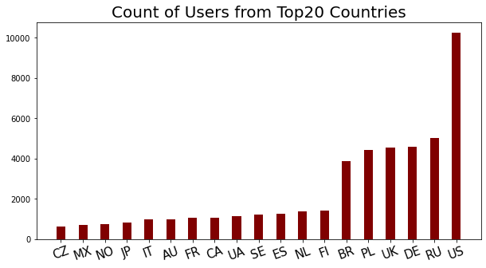
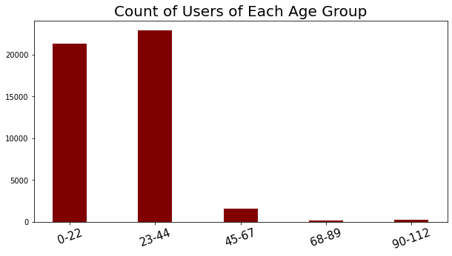
EDA
the US, Russia, Denmark, the UK, Poland and Brazil have the most number of users
Most of the users are from the young adult group (0-22) and the mid-age group(23-44).
Notes:
Also, male users are twice as many as female users. Long tail effect of the listening events.

Slide 6
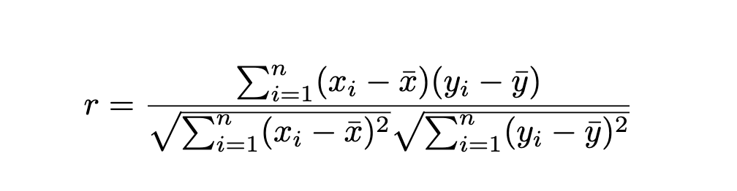
Collaborative Filtering
Baseline model: Based on the similarities of rows in the sampled User-Artist-Matrix
Building up on our collaborative filtering model, we further improve on its performance by sorting the playcounts for the recommended artists.

Slide 7
Demographic Filtering
Specifically, we consider users' gender, age, and country of residence to define a user similarity matrix.
Binary criteria for gender
Binary criteria for country of residence
Graded criteria for age
Using this matrix, we identify the K most similar users to the target user based on their demographic characteristics.
We then combine these three similarity functions linearly, giving equal weights to all components. Finally, we perform aggregations through the collaborative filtering approach to recommend the top N artists to the target user.
Notes:
We also implemented Demographic filtering, which takes into account the findings we obtained in the user profile. we incorporate this filtering method as an additional approach to recommending artists to users.
Specifically, we consider users' gender, age, and country to define the similarity matrix.
To determine the similarity, we use binary criteria for gender and country(1 if same gender/country as the target user, 0 otherwise) and graded criteria for age (e.g., it is 0.8 if the age difference is between 1 and 2 years, 0.5 for 2 and 9 years, 0.2 if for 9 and 15 years).
We then combine these similarity functions linearly, giving equal weights to all components to find K similar users.
Finally, we perform aggregations through the collaborative filtering approach to recommend the top N artists to the target user.

Slide 8
Hybrid Filtering
It integrates both demographic filtering and collaborative filtering approaches to combine the results of the two recommendations using median normalization.
Normalize the ranking scores given by each system based on the median value of the scores.
Artists suggested by both recommendations -> compute the new score as the arithmetic mean of both original scores.
All other artists -> take the original normalized scores.
It balances the contributions of each recommendation and improve the quality of recommendations. Based on the ranking obtained by sorting with respect to the new scores, we then recommend the top N artists to the user.
Notes:
we also propose a hybrid recommendation system that integrates both demographic and collaborative filtering approaches. We adopt the strategy that combines the results of the two recommendations using median normalization.
Specifically, we first normalize the ranking scores given by each system by median.
Next, for artists that are suggested by both recommendations, we compute the new score as the mean of both original scores. For all other artists, we take the original scores.
Based on the ranking obtained by sorting the new scores, we then recommend the top N artists to the user.
This hybrid recommendation system has the potential to provide more accurate and diverse recommendations to users, and we would expect it to perform better than each individual recommendation system.

Slide 9
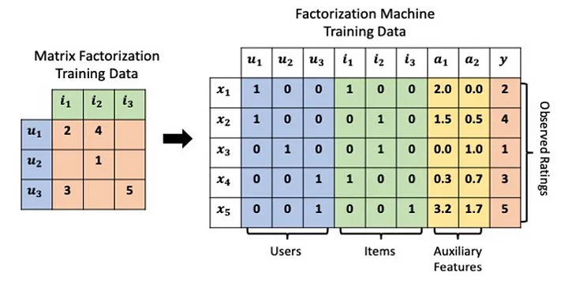
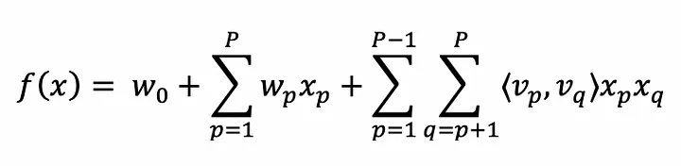
Factorization Machine
Key Concepts:
Factorization Interaction Parameters
Learning-to-Rank (LTR)
Versatile, can give nearest neighbor users, or item recommendations
Each row
Each interaction
The loss functions are based on the relative ordering of items instead of their raw scores

Slide 10
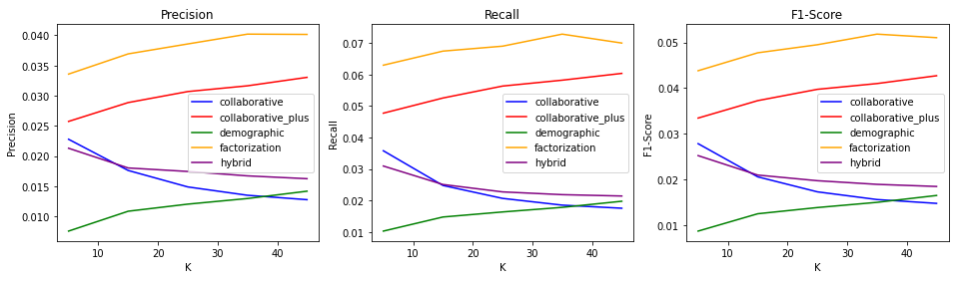
Evaluation
 | precision | recall | F1 score
FM Direct Forecast | 0.0485 | 0.0979 | 0.0649
Notes:
We evaluated our five models with K = 5, 15, 25, 35, 45, as you can see from the three plots of Precision, Recall, and F1-Score. It seems like factorization machine and the improved collaborative filtering are outperforming the rest of the models with K= 35 giving the best performance.
We could also see that hybrid filtering is not able to out-perform the individual filterings it has integrated, the potential reason could be how we combined the results from two filterings. Here we suspect that the result was dominated by demographic filtering as the performance of these two are similar.
(FM Direct Forecast to be added here …)

Slide 11
Conclusion & Next Steps
Adjusting the weight between collaborative filtering and demographic filtering in the hybrid model.
Improving on more nuanced adjustments of the values of neighbors K, as well as the number of recommendations to give.
In terms of evaluation, another approach would be to mask 10% of the users off as the validation or testing set.

Slide 12
References
[1] Schedl, M. (2021, February 2). Front. Artif. Intell.Sec. Machine Learning and Artificial Intelligence Volume 3 - 2020 | https://doi.org/10.3389/frai.2020.508725
[2] Schedl, M. Investigating country-specific music preferences and music recommendation algorithms with the LFM-1b dataset. Int J Multimed Info Retr 6, 71–84 (2017). https://doi.org/10.1007/s13735-017-0118-y
[3] Schedl, M. (2017). Large-scale Analysis of Group-specific Music Genre Taste From Collaborative Tags. Journal of Music and Technology 5(1), 1-14. https://doi.org/10.1145/3078072.3078076
[4] Schedl, M. (2016, June). The lfm-1b dataset for music retrieval and recommendation. In Proceedings of the 2016 ACM on international conference on multimedia retrieval (pp. 103-110).
[5] Stackexchange. (n.d.). 2x2 confusion matrix. [online forum post]. Retrieved on 11th February 2023 from ttps://tex.stackexchange.com/questions/505915/2x2-confusion-matrix
[6] The Verge. (2019, September 6). Streaming revenue drives growth in the music industry. Retrieved from https://www.theverge.com/2019/9/6/20852568/streaming-revenue-growth-spotify-apple-music-industry-ariana-grande-drake-taylor-swift

